Slide 1
Discussion Voice Activity 1.03
Spanish 2

Slide 2
Vocabulario: En el comedor
Poner la mesa (to set the table)
La comida (Food)
el mantel tablecloth
el tenedor fork
el cuchillo knife
la cuchara spoon
la cucharita teaspoon
el plato plate
el vaso glass
la mesa table
la silla chair
la sal salt
la pimienta pepper
la servilleta napkin
el pollo chicken la manzana apple
las frutas fruits la naranja orange
la banana banana la pera pear
la piña pineapplel las uvas grapes
las fresas strawberriesl la carne meat
las zanahorias carrots las habichuelas green beans
lel maíz corn las habas beans
la papa potato el postre dessert
la torta cake el pastel pie
el helado ice cream
el pescado fish
la ensalada salad
el refresco drink
el café coffee
la limonada lemonade
el agua water
las verduras, las legumbres , los vegetales vegetables

Slide 3
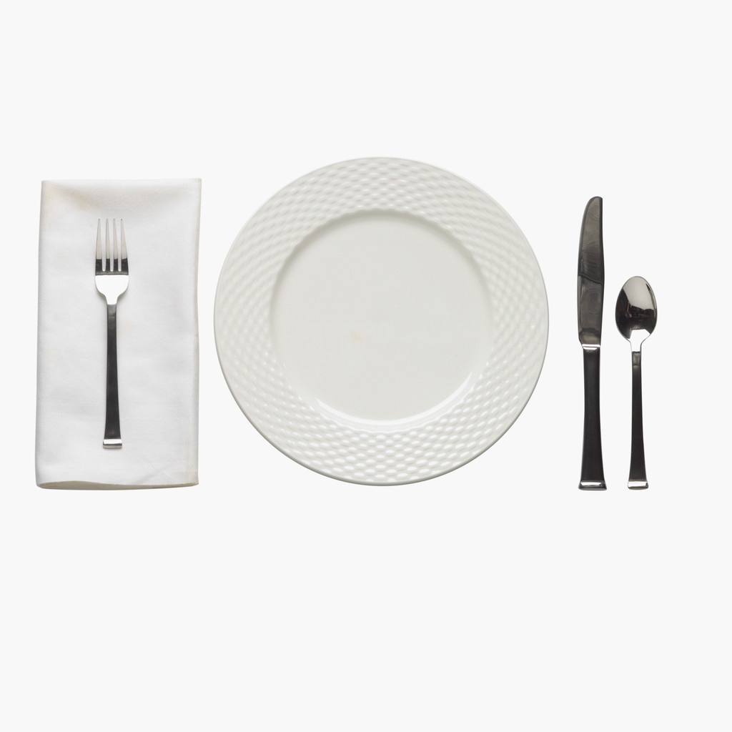
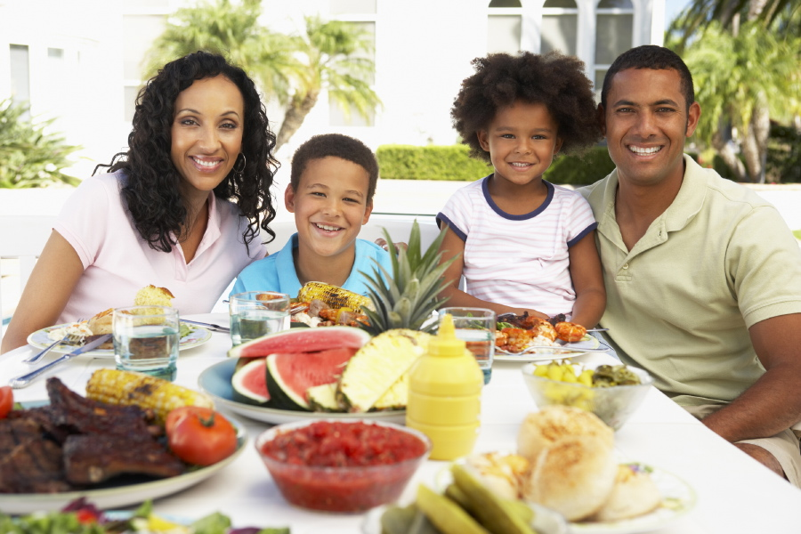
Question: ¿ Qué hay en la mesa ?
En la mesa hay ____, _____, _____, ______ y _____.
(Replace the blanks with vocabulary words from the previous slide. Then COPY/PASTE into the 1.03 Student Comments box, in the ASSESSMENTS section of the course. Don’t forget your recording!)
What’s on the table? On the table there is ___,___,___,___ and ___.

Slide 4
NEXT…
AFTER YOU SUCCESSFULLY FINISH YOUR DISCUSSION VOICE ACTIVITY, PLEASE GO BACK TO THE LESSONS TAB, AND CHOOSE MODULE 1, LECCIÓN 1.03. CAREFULLY READ AND STUDY THE LECCIÓN and ESTRUCTURA PAGES, TO REVIEW THE PRESENT TENSE OF REGULAR VERBS IN SPANISH ( TO TALK ABOUT WHAT PEOPLE DO). THIS WILL HELP YOU A LOT TO LEARN THE MATERIAL, DEVELOP YOUR SPANISH SKILLS, AND DO WELL WHEN YOU TAKE THE MODULE EXAM.

