Slide 1
Discussion Voice Activity 1.08
Spanish 2

Slide 2
What you need to study / know:
Family members vocabulary ( el padre, la madre, el abuelo, la abuela, el primo, la prima, el tío, la tía, el hermano, la hermana, etc. ) NOTE: LOOK AT THE WHOLE LIST OF FAMILY VOCABULARY ON THE LECCIÓN page of Lesson 1.08 )
Possessive adjectives: ( mi, mis, tu,tus, su,sus, nuestros, nuestras, nuestro ,nuestra):SEE Estructura page of Lesson 1.08 for translations.
Stem changing verb “venir” ( to come) : yo vengo( I come), tú vienes ( you come ),
Él viene, Ella viene, Ud, viene ( He comes, She comes, You come ), Ellos vienen, Ellas vienen, Ustedes vienen ) They come, You all come )

Slide 3
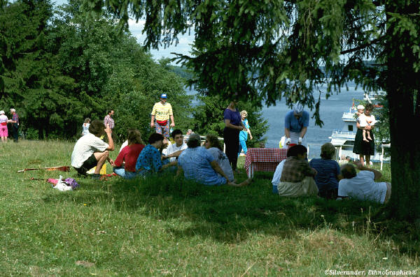
Discussion Question: Hay una reunión de familia. ¿Quiénes vienen? ( There is a family reunión. Who is coming? )
→ Mi ______, mi _______, mis _________ y mis __________ vienen a la reunión de familia.
My ___, my ____, my ____ and my _____ are coming to the family reunion.
NOTE: Be careful while using SINGULAR and PLURAL NOUNS. How do you match mi and mis with a singular or plural noun?

Slide 4
NEXT…
Record your voice in the Discussion Groups tab of the Menu. Choose 1.08, and Reply to the message posted there. Next, go to ASSESSMENTS tab, and let me know you posted in the Voice Discussion Group.
AFTER YOU SUCCESSFULLY FINISH YOUR DISCUSSION VOICE ACTIVITY, PLEASE GO BACK TO THE LESSONS TAB, AND CHOOSE MODULE 1, LECCIÓN 1.08. CAREFULLY READ AND STUDY THE LECCIÓN and ESTRUCTURA PAGES, TO REVIEW THE PRESENT TENSE OF REGULAR VERBS IN SPANISH ( TO TALK ABOUT WHAT PEOPLE DO).
THEN, DOWNLOAD THE WORK FILE YOU’LL FIND IN THE PRÁCTICA TAB, and SELF CHECK YOUR WORK WITH THE ANSWER KEY PROVIDED. THIS WILL HELP YOU A LOT TO LEARN THE MATERIAL, DEVELOP YOUR SPANISH SKILLS, AND DO WELL WHEN YOU TAKE THE MODULE EXAM.

